Slide 1

Generative AI and Cybersecurity @ SRMIST Kattankulathur, Chennai
Dr. Bhale Pradeepkumar Gajendra
Assistant Professor
Indian Institute of Information Technology, Design and Manufacturing, Kancheepuram
Notes:
Gud evening one and all, today I am presenting my annual progress seminar, under the supervision of Prof Sukumar Nandi and dr. Santosh Biswas

Slide 2



Education Qualification
PhD in Computer Science and Engineering (CSE)
Indian Institute of Technology Guwahati, Assam India (July 2016 - April 2024)
Advisors: Prof. Sukumar Nandi (IIT Guwahati) and Prof. Santosh Biswas (IIT Bhilai)
M.Tech in CSE (Specialization: Information Security)
ABV-Indian Institute of Information Technology and Management, Gwalior (2012 - 2014)
Advisors: Prof. Shashikala Tapaswi
BE in CSE
Government College of Engineering, Aurangabad, Maharashtra (2006 - 2010)
Advisors: Prof. Praveen Revankar
Teaching and Industry Experience
Assistant Professor , IIIT Pune (Sept 2023 – December 2025)
Assistant Professor , NIT Jalandhar (Aug 2014 – June 2016)
Technical Associate, Tech Mahindra, Pune (July 2010 – May 2012)

Slide 3
Research Work
Major Areas of Research: Computer Networks, Internet of Things (IoT), and Security
Thesis Title: Attack Detection and Mitigation for IoT Ecosystems: Adaptive, Scalable, and Lightweight
Approaches
Thesis Contributions:
i) Edge-based ML Intrusion Detection System (IDS) ii) Distributed Packet Inspection Agent (PIA)
iii) Mixed-Rate DDoS (MRDDoS) Detection System iv) Roaming IDS for Mixed Attack Detection
Publications
OPTIMIST: Lightweight and Transparent IDS with Optimum Placement Strategy to Mitigate Mixed-rate DDoS Attacks in IoT Networks IEEE IoT Journal .
A Hybrid IDS for Detection and Mitigation of Sinkhole Attack in 6LoWPAN Networks, in Springer International Journal of Information Security.
Effective injection of adversarial botnet attacks in IoT ecosystem using evolutionary computing. Internet Technology Letters: e433.
A Novel Energy-efficient Scheme For RPL Attacker Identification In IoT Networks Using Discrete Event Modeling, IEEE Access​
EDAS-6N: An Energy Aware Edge Assisted Mixed Rate DDoS Attack Detection and Mitigation in 6TiSCH Network, ” in ACM Transactions on Internet of Things (TIOT)

Slide 4
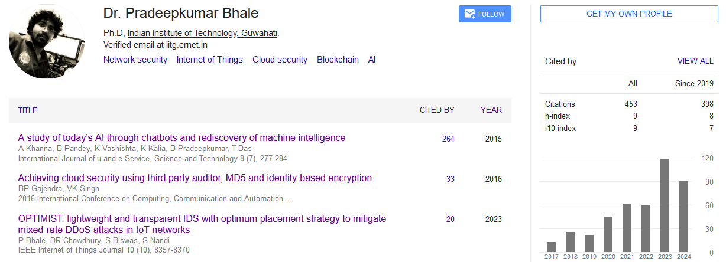
Publications, Awards and Grants
Academic and Research Summary: | Count
Indexed Journals (Published) | 5
Indexed Journals (Under Review) | 3
Conferences | 15
Book | 1
Book chapter | 2
Citations: 582+, h-index: 10, i10-index: 10
Young Scientist Award
Research Excellence Award (PhD - National)
Energy Efficient Detection of Sinkhole Attack using Roving IDS in 6LoWPAN
Presented in the 20th International Conference on Innovations for Community Services (I4CS 2020), January 12-15, 2020, a top-tier international conference.
IEI-FCRIT Excellence Award (Special Recognition)

Slide 5
Overview of Security Concepts:
Introduction to Security Concepts
Security domains aim to protect systems, networks, and information from unauthorized access, damage, and disruptions.
They include:
- Computer Security
- Network Security
- Cybersecurity
- Information Security

Slide 6
Computer Security
Definition: Protecting individual computer systems from unauthorized access, damage, or disruptions.
Key Objectives:
- Confidentiality: Prevent unauthorized access to data.
- Integrity: Ensure data/software remain unaltered.
- Availability: Keep systems operational.
Examples:
- Antivirus software
- Disk encryption
- Secure boot

Slide 7
Network Security
Definition:
Securing infrastructure to ensure data integrity and confidentiality during transmission.
Key Objectives:
- Confidentiality: Prevent eavesdropping.
- Integrity: Protect data from alteration.
- Availability: Maintain network accessibility.
Examples:
- Firewalls
- Intrusion Detection/Prevention Systems

Slide 8
Cybersecurity
Definition:
Protecting internet-connected systems and data from cyber threats.
Key Objectives:
- Prevent Unauthorized Access: Mitigate attacks like phishing, ransomware.
- Ensure Resilience: Recover from incidents quickly.
- Threat Intelligence: Respond to evolving threats.
Examples:
- Endpoint Detection/Response
- Cybersecurity awareness training

Slide 9
Information Security
Definition:
Protecting information (digital and physical) by ensuring its confidentiality, integrity, and availability.
Key Objectives:
- Confidentiality: Protect sensitive information.
- Integrity: Ensure data accuracy.
- Availability: Ensure access to information.
Examples:
- Data encryption
- Access control

Slide 10
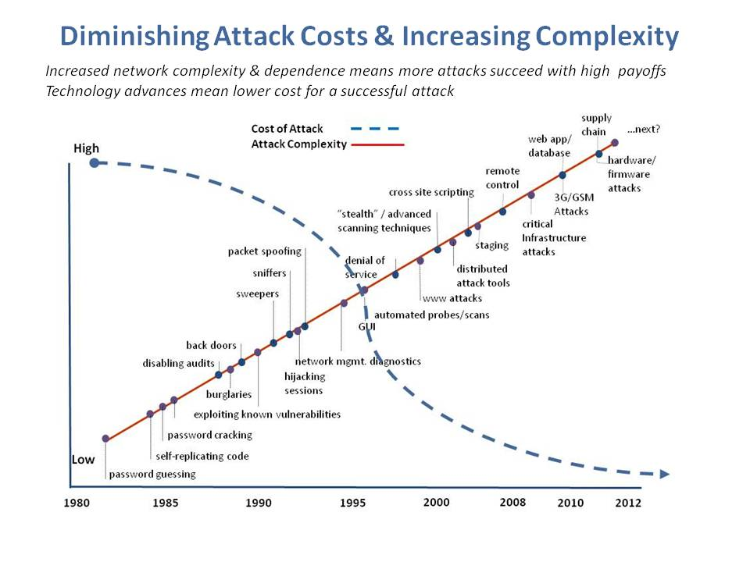

Slide 11
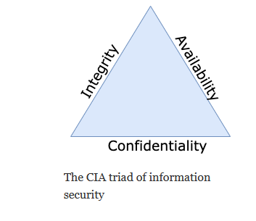
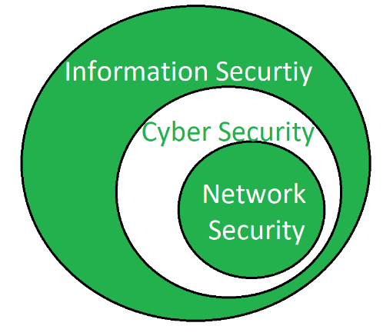
Information Security

Slide 12
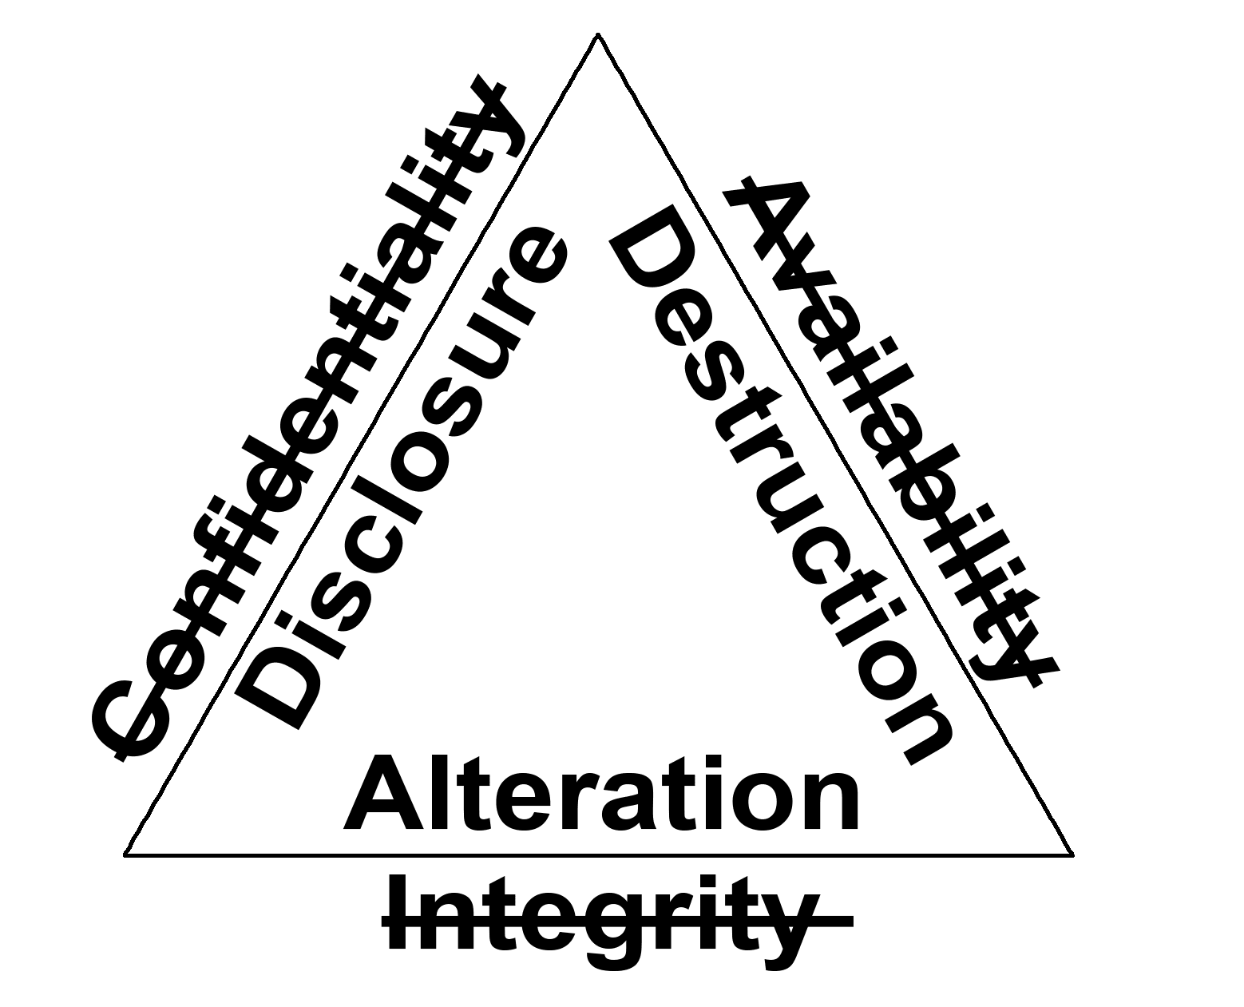
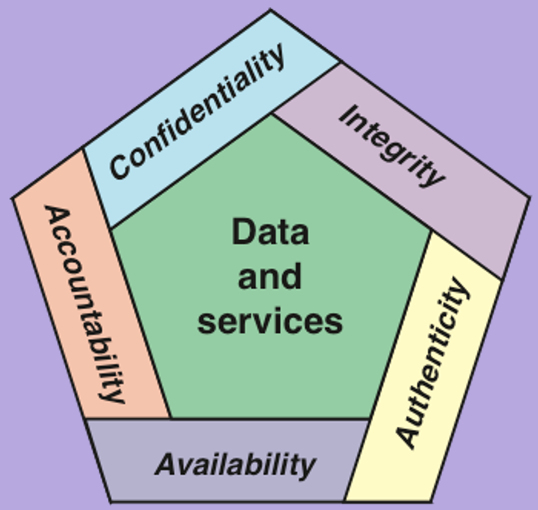
Cybersecurity
CIA Triad and its opposites

Slide 13
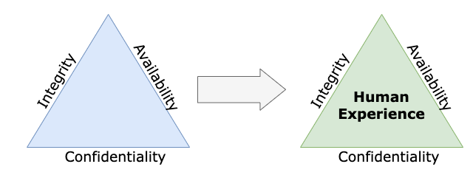
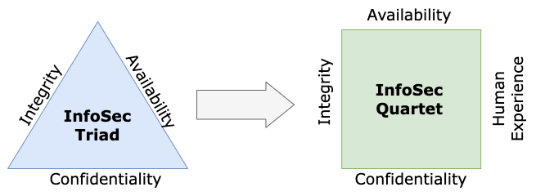
Cybersecurity

Slide 14
Military Example
Cybersecurity
Confidentiality: target coordinates of a missile should not be improperly disclosed
Integrity: target coordinates of missile should be correct
Availability: missile should fire when proper command is issued

Slide 15
Commercial Example
Cybersecurity
Confidentiality: patient’s medical information should not be improperly disclosed
Integrity: patient’s medical information should be correct
Availability: patient’s medical information can be accessed when needed for treatment

Slide 16
Question 1: What is the trade off between the security objectives?
Cybersecurity

Slide 17
Trade-Offs
Confidentiality vs. Availability:
Strengthening confidentiality (e.g., through encryption) can impact availability by increasing processing overhead and reducing system performance.
Integrity vs. Availability:
Measures to ensure data integrity (e.g., checksums, audits) can consume system resources and reduce availability.
Confidentiality vs. Integrity:
Protecting confidentiality may involve obscuring data, which can make it harder to verify its integrity.
Resource Constraints:
Achieving all three objectives simultaneously may not always be feasible in resource-constrained environments

Slide 18
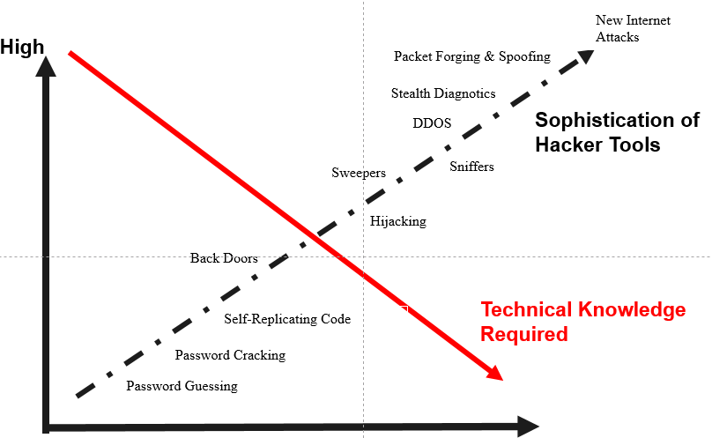
Attack VS Technical Knowledge Required

Slide 19
Threat
• Definition: A threat is any potential event or action that can cause harm by exploiting a vulnerability.
• Characteristics:
- Includes both intentional (e.g., hacking) and unintentional (e.g., natural disasters) events.
- Threats can disrupt confidentiality, integrity, and availability of systems.

Slide 20
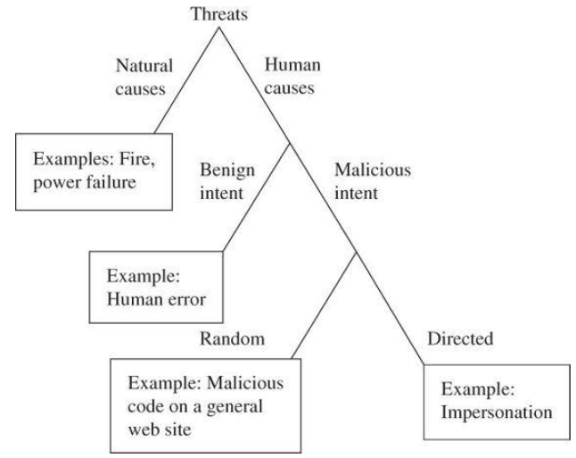

Slide 21
Risk
Definition: Risk refers to the potential for loss or damage when a threat exploits a vulnerability.
• Key Elements:
- Probability: Likelihood of a threat exploiting a vulnerability.
- Impact: Consequences or severity of the exploitation.
• Risk Management:
- Involves identifying, analyzing, and mitigating risks to reduce potential harm.
Risk = Threat × Vulnerability × Impact:
If the likelihood of a threat is 40%, the system's vulnerability is 50%, and the impact is $ 50,000, calculate the risk.
Risk = 0.4 × 0.5 × $50,000 = $10,000.

Slide 22
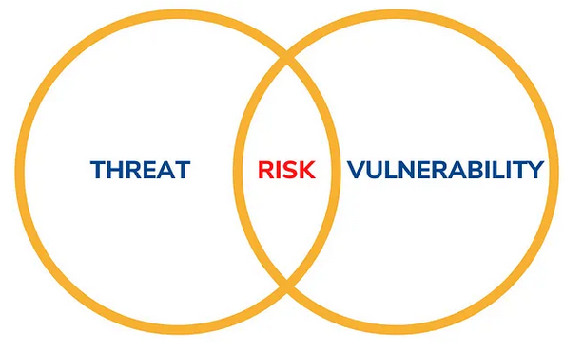
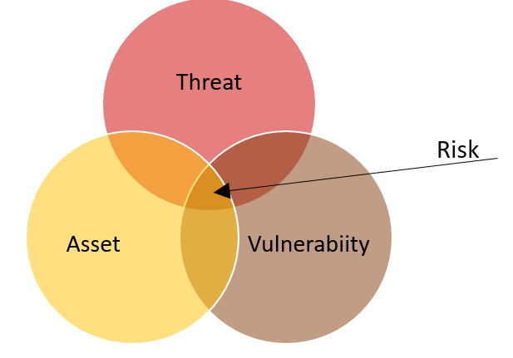

Slide 23
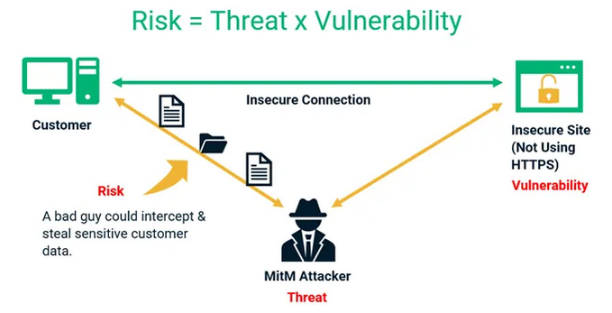

Slide 24
Attack
• Definition: An attack is a deliberate action taken to exploit vulnerabilities in a system.
• Characteristics:
- Can be active (e.g., data modification) or passive (e.g., data interception).
- Targets confidentiality, integrity, or availability of systems or data.

Slide 25
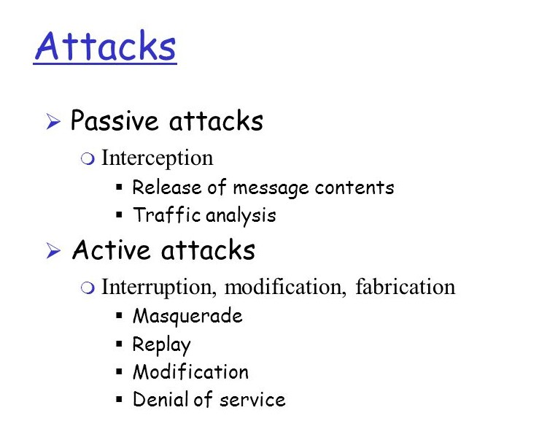

Slide 26
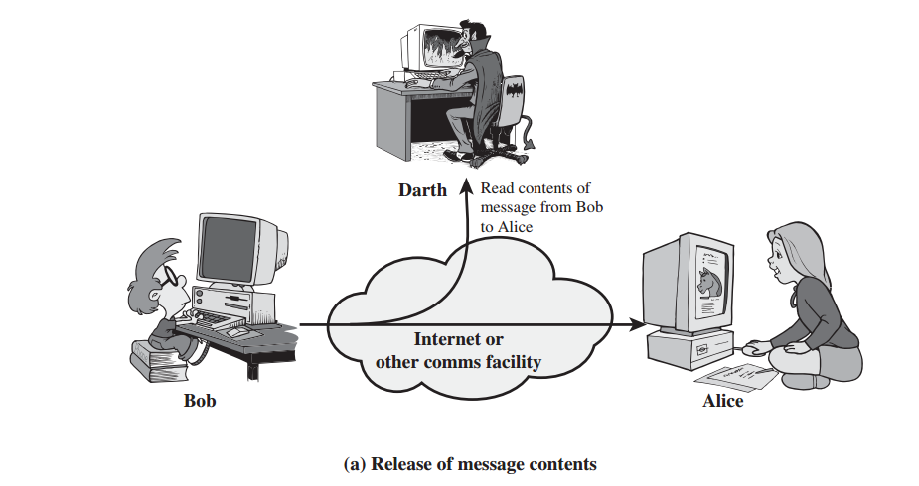

Slide 27
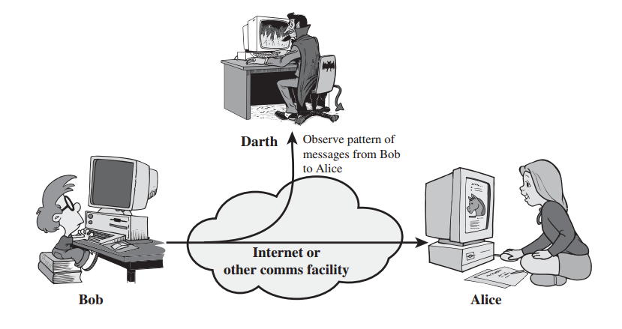

Slide 28
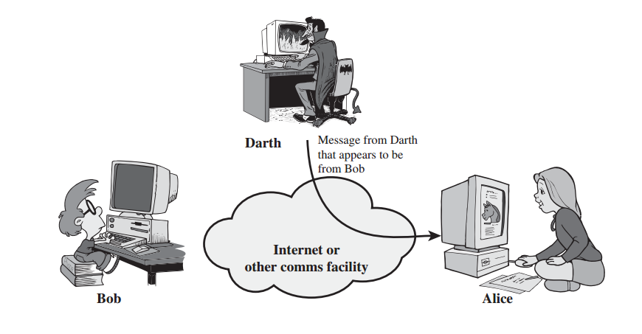

Slide 29
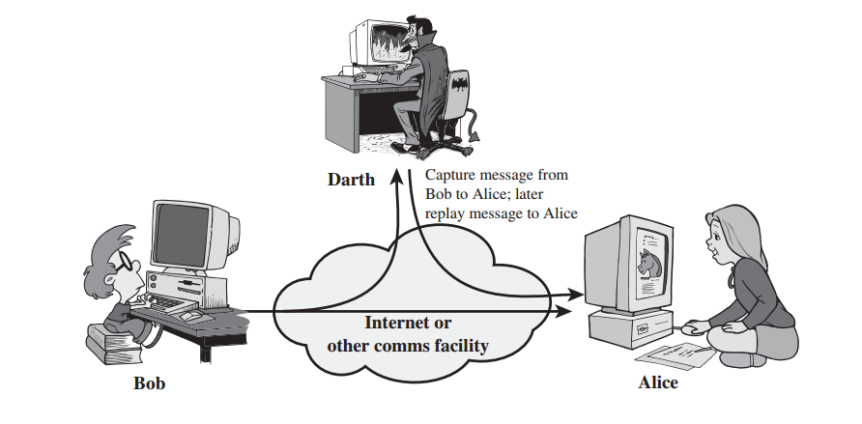

Slide 30
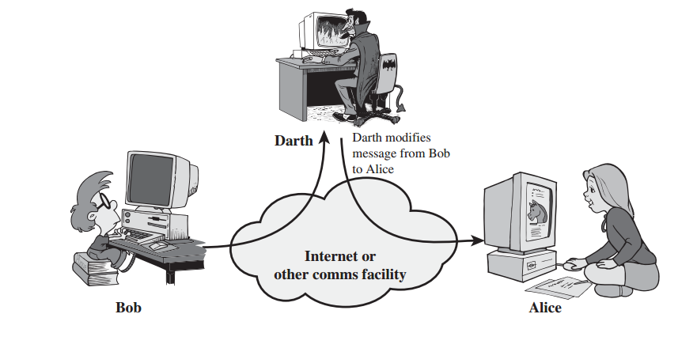

Slide 31
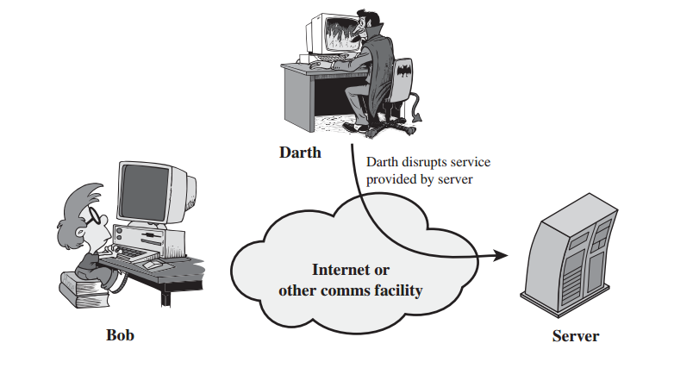

Slide 32
Relationships Between Concepts
• Flow:
Vulnerability → Exploited by Threat → Leads to Risk → Results in Attack
• Example:
- Unpatched server → Hacker (threat) → Risk of data theft → Attack occurs.

Slide 33
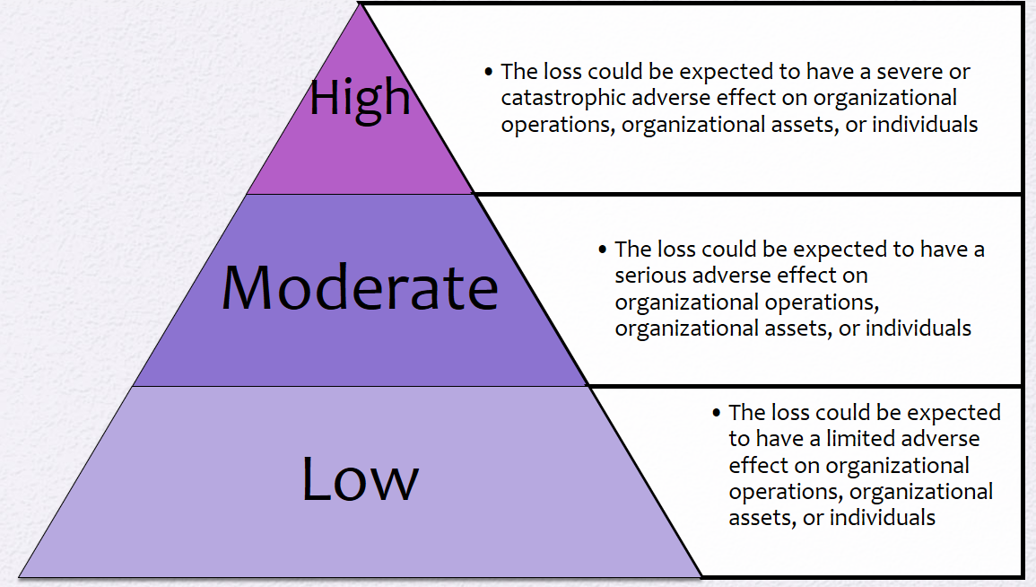
Information Security

Slide 34
Attack surfaces
Attack surface: the reachable and exploitable vulnerabilities in a system
Open ports
Services outside a firewall
An employee with access to sensitive info
…
Three categories
Network attack surface (i.e., network vulnerability)
Software attack surface (i.e., software vulnerabilities)
Human attack surface (e.g., social engineering)
Attack analysis: assessing the scale and severity of threats

Slide 35
Attack trees
A branching, hierarchical data structure that represents a set of potential vulnerabilities
Objective: to effectively exploit the info available on attack patterns
Security analysts can use the tree to guide design and strengthen counters measures

Slide 36
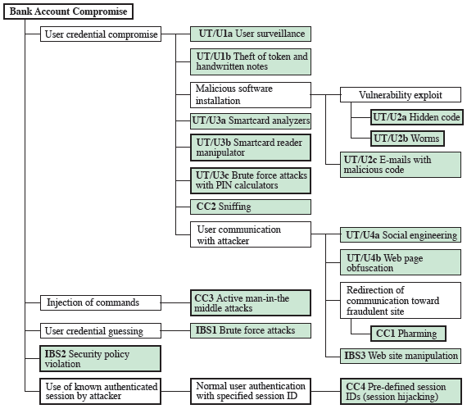
Attack trees

Slide 37
Recap of the Last Lecture

Slide 38
Recap of the Last Lecture

Slide 39
Various Attack on CPS

Slide 40


DDoS attack in CPS
DoS and DDoS attacks are very harmful to IoT systems as these attacks disrupt the availability of systems.
DDoS attacks, which can be broadly classified into following categories, as given below
High-rate DDoS attack (HrDDoS):
Low-rate DDoS Attacks (LrDDoS):
Mixed-rate DDoS Attacks (MrDDoS):
Fig. 1: DoS Attacks

Slide 41
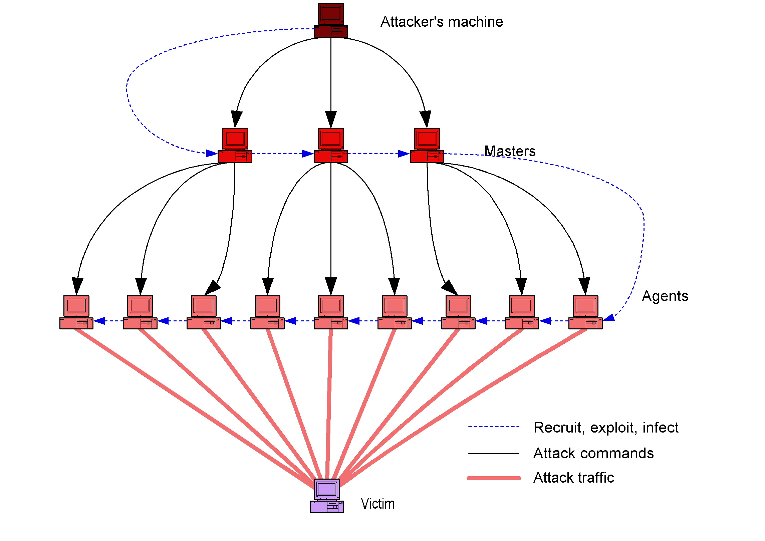
DDoS attack in IoT
Collateral damage points
Fig. 2: DDoS Attack
Fig. 3: Botnet Attack

Slide 42
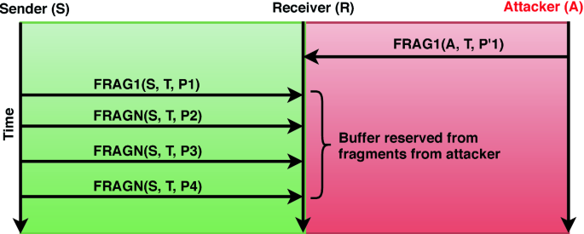
Buffer Reservation Attack

Slide 43
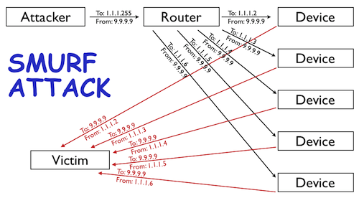
Smurf Attack

Slide 44
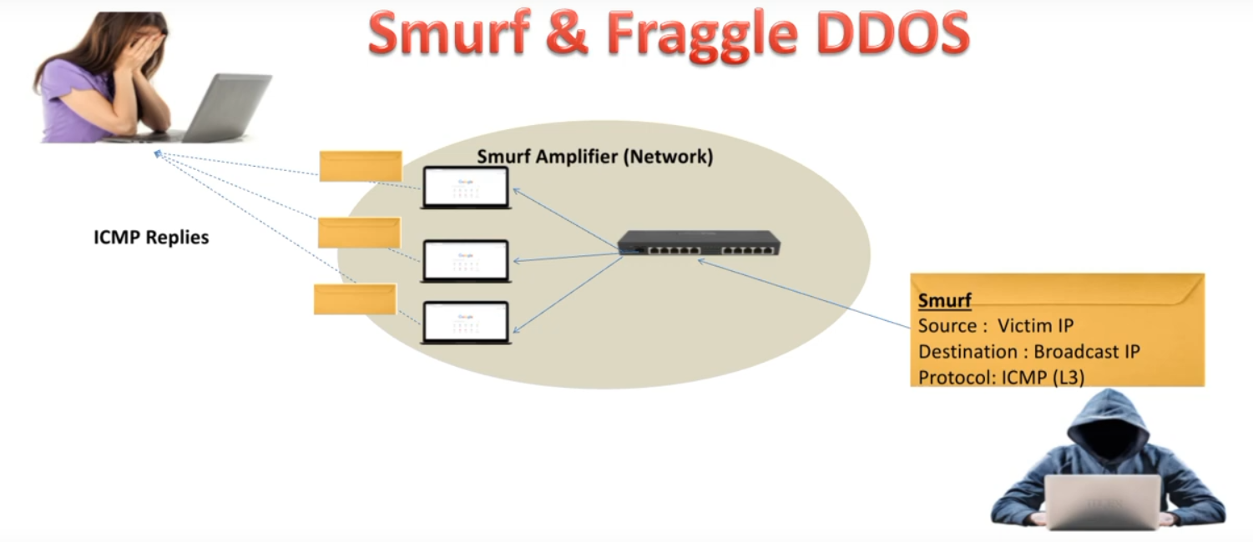
Smurf Attack

Slide 45
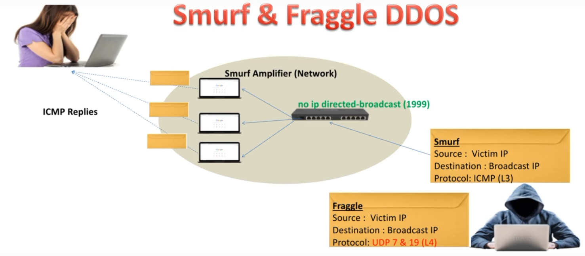
Fraggle Attack

Slide 46
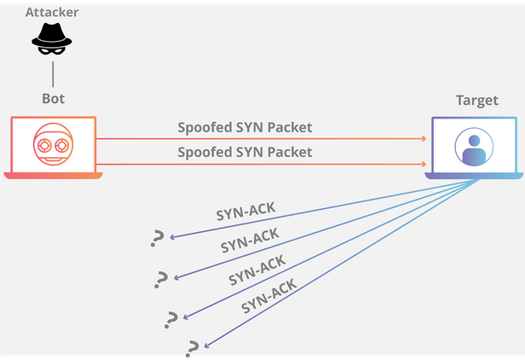
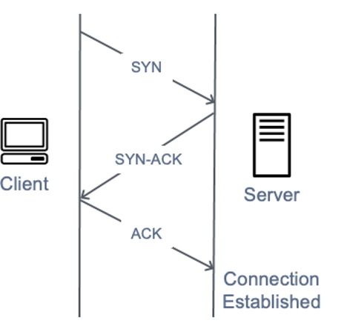
Syn flood attacks

Slide 47

Live Cyber Threat Map
https://threatmap.checkpoint.com/

Slide 48


Zero Day Attack

Slide 49
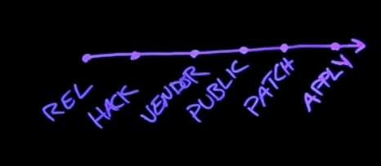
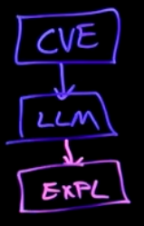

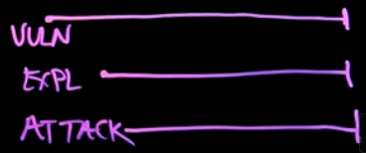
Zero Day Attack
Common Vulnerabilities and Exposures

Slide 50
Security Approaches

Slide 51
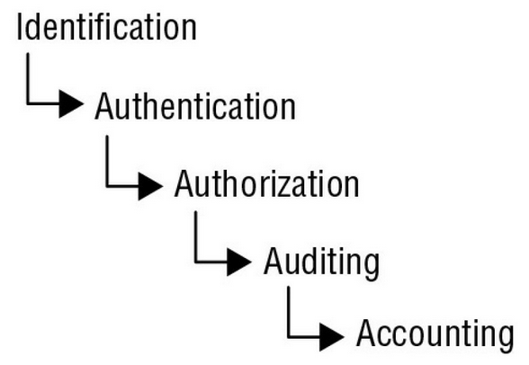
Access Control

Slide 52
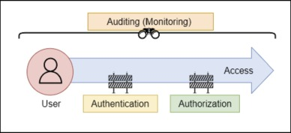
Access Control

Slide 53
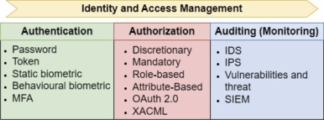
Access Control

Slide 54
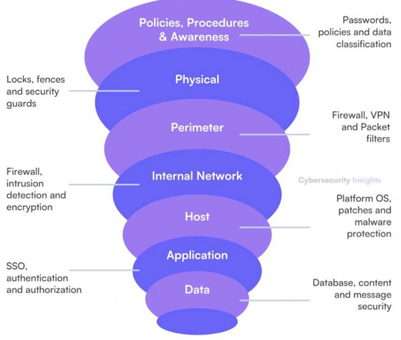
Defense-in-depth

Slide 55

Presentation Outline
Introduction and Motivation
Research Contributions
Conclusion and Future work
Publication of thesis
References
DDoS attacks including Botnet attacks detection and mitigation in IoT ecosystem
LRDDoS attacks detection and mitigation
Mixed Rate DDoS attack detection (HRDDoS and LRDDoS attacks)
Multiple Mix attack detection

Slide 56
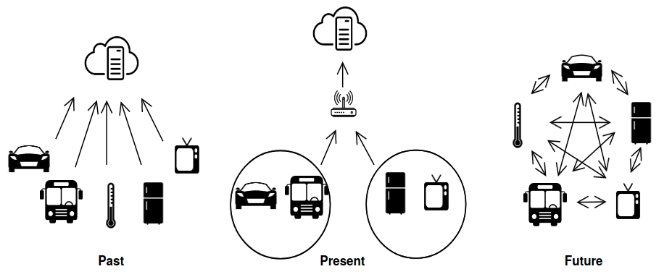
Introduction and Motivation
Internet of Things (IoT) is a network of sensors, actuators, embedded and wearable devices that can connect to the Internet.
Fig. 1: Evolution of IoT [1]

Slide 57
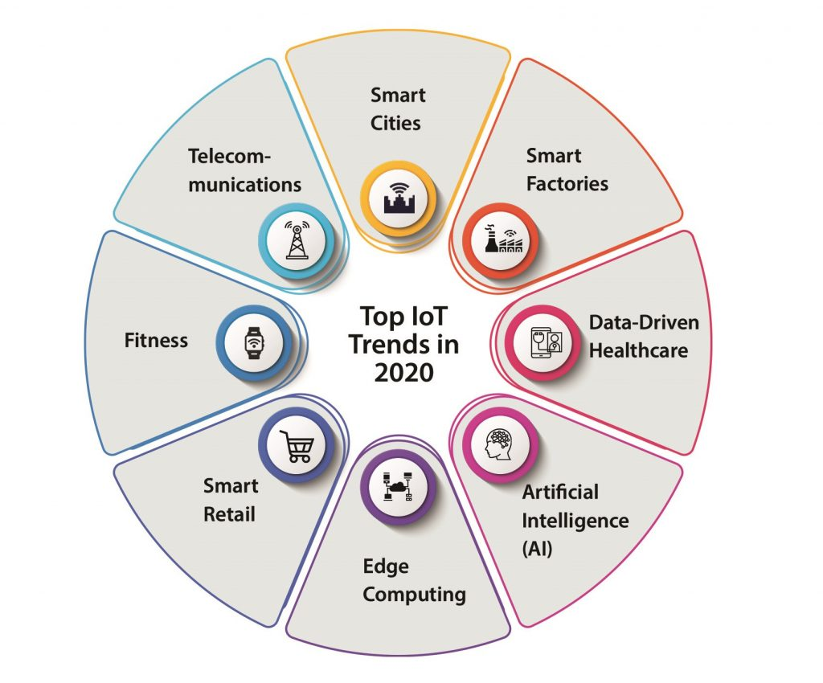
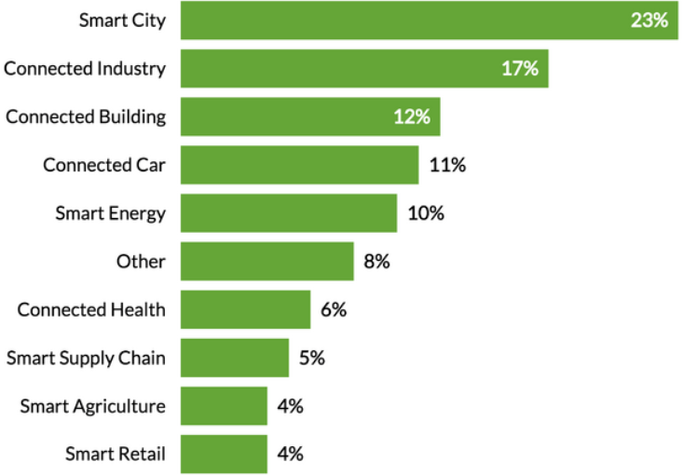
Introduction and Motivation
Use of IoT is rising across a lot of sectors, including smart homes, smart vehicles, and smart health monitoring devices [1].
Fig. 2: Various Sector of IoT
Fig. 3: Data source: IoT analytics database of project [11]

Slide 58
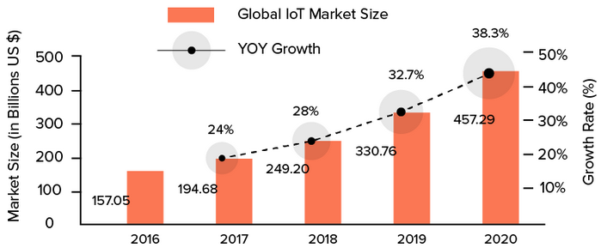
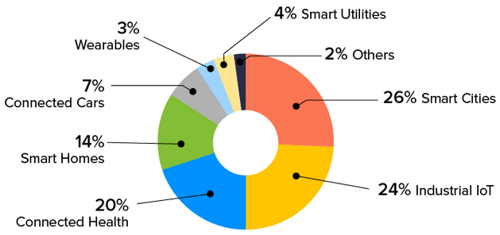
Introduction and Motivation
The global IoT market was valued at approximately $157.05 billion in 2016.​
The global IoT market is projected to surpass $1.5 trillion by 2023, demonstrating continued strong growth.
Fig. 4: Global IoT Market Size year wise
Fig. 5 : Global IoT Market Share by Sub-Sector

Slide 59
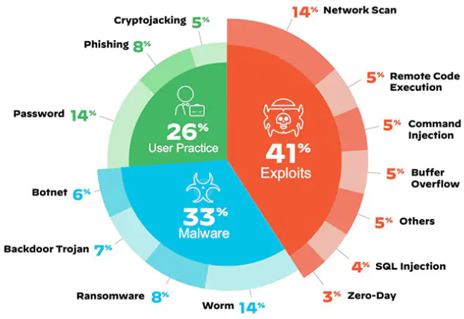
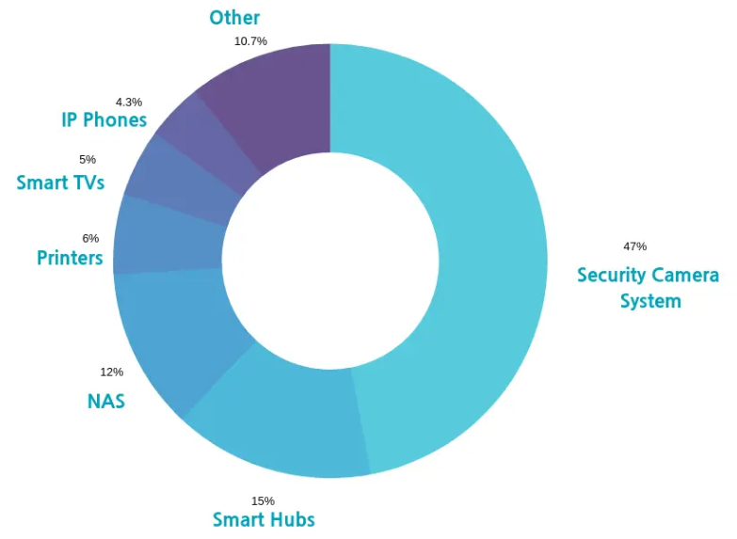
Introduction and Motivation
With IoT system benefits, It is vulnerable to many attacks.
Attack objective to violate authenticity, integrity, confidentiality, and availability.
The violation of any of them may incur serious consequences.
Fig. 6: Breakdown of top IoT threats​
Fig. 7: Breakdown of IoT devices in smart home with vulnerability​

Slide 60
Attacks Considered for Research
Exploits:
Denial-of-Service (DoS)
Distributed Denial-of-Service (DDoS)
Low-rate DDoS attacks (LRDDoS)
Rank attacks
Sinkhole attacks
Wormhole attacks
Buffer reservation attacks
Malware attack:
Botnets

Slide 61

First Contribution
DDoS attacks including Botnet attacks detection and mitigation in IoT ecosystem
ML for IEEE 802.15. 4e/TSCH: Energy Efficient Approach to Detect DDoS Attack Using Machine Learning
BlooM: Bashlite and Mirai Botnet Detection using Machine Learning Algorithms in 6LoWPAN Network

Slide 62
Mitigating DDoS and Botnet attacks in IoT
Attack: DDoS, Botnet Attack
DDoS attacks are very harmful to IoT systems as these attacks disrupt the availability of systems.
DDoS attacks, which can be broadly classified into following categories, as given below
High-rate DDoS attack (HrDDoS):
Low-rate DDoS Attacks (LrDDoS):
Mixed-rate DDoS Attacks (MrDDoS):
Fig. 7: DoS Attacks

Slide 63
Mitigating DDoS and Botnet attacks in IoT
Collateral damage points
Fig. 8: DDoS Attack
Fig. 9: Botnet Attack

Slide 64
Mitigating DDoS and Botnet attacks in IoT
Motivation behind the Contribution 1
DDoS attacks are on the rise. There is a 48% increase in DDoS attacks. As per State of Application Security report Q1, 2023.
Disrupting Critical Infrastructure such as financial institutions, public utilities, to cause widespread disruption, and undermine trust in these systems.
DDoS attacks are high on the list of dangerous cyber threats.

Slide 65
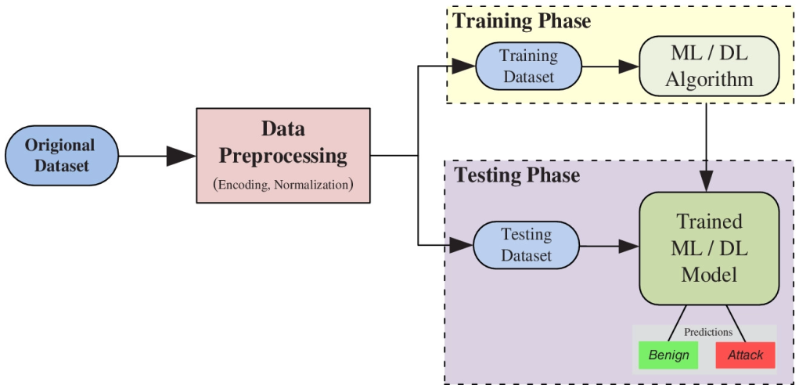
DDoS Attack Detection using ML
IoT N/W Traffic:
N/W traffic gathered with the help of inhouse experiment and publicly available datasets
Data Preprocessing
Encoding, Normalization
ML model:
Fitting Naive Bayes to the Training data Set:
(generated data and available data set [11])
Fig. 11 : Naive Bayes -based IDS methodology
Classification:
Classify DDoS attack traffic and benign traffic.

Slide 66
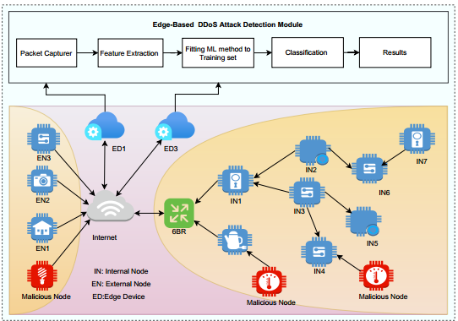
DDoS Attack Detection using ML
Contribution Overview
IoT ecosystem contains resource constrained devices.
It contain 2 type of node: Legitimate node (NL), and Spiteful node (NS).
The ML based IDS module executes on the edge device (ED) of the IoT networks.
Fig. 10: IoT Network Topology

Slide 67
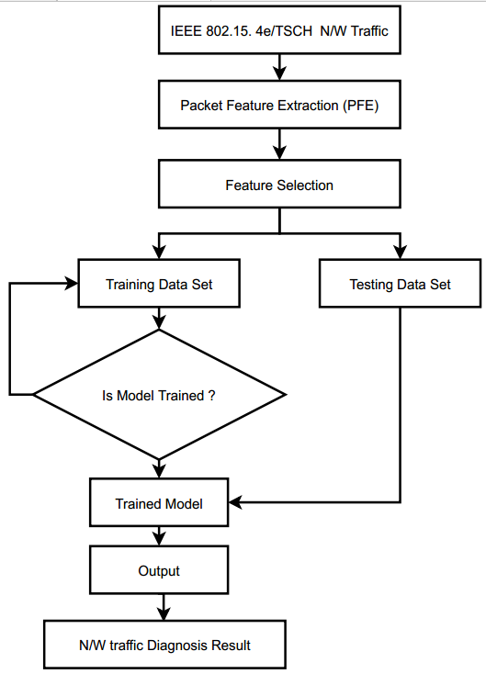
DDoS and Botnet Attack Detection using ML
Flow chart of DDoS and Botnet attack detection:
We used same flow chart for DDoS and Botnet attack detection
Only difference is ML model and Dataset
Fig. 13. Flow chart of DDoS and Botnet attack detection system

Slide 68
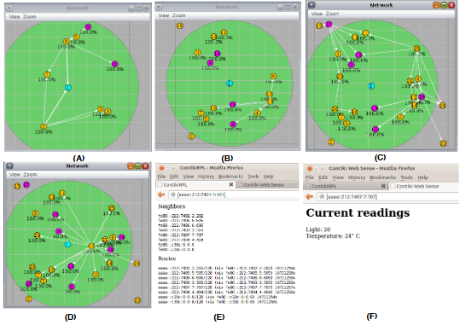
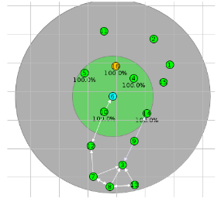
DDoS and Botnet Attack Detection using ML
Experimental Setup and Implementation
Exp. 1: Non-attack scenario
Exp. 2: DoS/ DDoS and Botnet attack scenario
Exp. 3: Implement Naive Bayes method with Exp. 2
Exp. 1: Non-attack scenario
Exp. 2 and 3: Attack scenario and attack with RENO
The experiment is conducted using 8,16, 32, 64, and 128 IoT nodes

Slide 69




DDoS and Botnet Attack Detection using ML
Experimental Setup and Implementation ​
Evaluated using:
Simulator : Cooja (Contiki-OS)
Dataset:
In house generated dataset (using Contiki Cooja)
ISCX [11], Kitsune [22], KDD 99' Cup [33]
Performance metrics :
Where,
FP = Legitimate activity wrongly classified,
TN = Legitimate activity recognized accurately,
FN = Spiteful activity wrongly classified,
TP = Spiteful activity recognized accurately

Slide 70
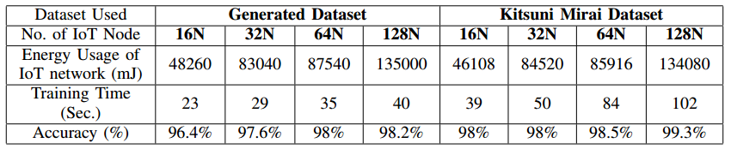
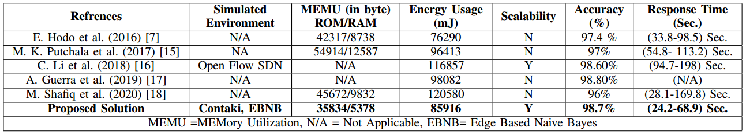
DDoS and Botnet Attack Detection using ML
Performance Evaluation
TABLE I: EVALUATION METRICS FOR GENERATED DATA AND KITSUNI MIRAI DATASET
TABLE II: COMPARISON OF THE PROPOSED STRATEGY WITH THE CLOSELY RELATED WORKS

Slide 71
DDoS and Botnet Attack Detection using ML
Summary
The performance of the proposed approach is assessed on the Contiki cooja with different data sets.
The results exhibit that the average accuracy and response time are 98.7% and (24.2-68.9) Sec. respectively, compared with the closely related work.

Slide 72

Second Contribution
LRDDoS attacks detection and mitigation in IoT ecosystem
LORD: LOw Rate DDoS Attack Detection and Mitigation Using Lightweight Distributed Packet Inspection Agent in IoT Ecosystem

Slide 73

LRDDoS attacks detection and mitigation in IoT ecosystem​
Attack: Low-rate DDoS Attacks (LRDDoS)
LRDDoS attacks are difficult to detect because the traffic they generate looks similar to legitimate traffic.
Attack is launched by sending a pulse. The average rate of attack traffic is very low, and the number of packets sent is very small.

Slide 74

LRDDoS attacks detection and mitigation in IoT ecosystem​
Contribution Overview
IoT ecosystem contains heterogeneous devices.
IoT network contain 3 type of node: 6BR node, Packet Inspecting Agent (PIA) node, Legitimate node (NL), and Spiteful node (NS).
The PIA module executes on the 6BR node and intermediate nodes for packet analysis.
Fig. 14: Experimental setup adopted for IoT implementation

Slide 75

LRDDoS attacks detection and mitigation in IoT ecosystem​
Contribution Methodology:
The proposed approach incorporates three phases as follows:
LRDDoS detection at 6BR
LRDDoS detection at PIA
Mitigation of LRDDoS attack
Fig. 15: Illustrative layout of proposed approach

Slide 76
LRDDoS attacks detection and mitigation in IoT ecosystem​
LRDDoS detection at 6BR
LRDDoS detection at PIA
Step 1: Data Collection ​ collect_network_traffic_data()​
Step 1: Data Collection ​
Step 2: Preprocessing​
Step 2: Preprocessing​
preprocess(network_traffic_data)
Step 3: Temporal Segmentation​
Step 4: GTV Calculation​
calculate_gtv(segmt_data[i], segmt_data[i + 1])​
Step 3: Temporal Segmentation​ segment_data(preprocessed_data)​
Step 5: Keep track on frequency of IP address
Maintain IP address and frequency count
Step 4: GTV Calculation​
calculate_gtv(segmt_data[i], segmt_data[i + 1])​
Step 6: Thresholding​ if gtv_value > threshold: and F_count > T_IPFc
Step 5: Thresholding​ if gtv_value > threshold:​
Step 7: Anomaly Detection handle_anomaly_detection(gtv_value and initiate mitigation process )
Step 6: Anomaly Detection handle_anomaly_detection(gtv_value)

Slide 77



LRDDoS attacks detection and mitigation in IoT ecosystem​
Mitigation of DDoS attack
Step 1: Identify attacked IP address and protocols​ based on Algorithm 1 and 2
Step 2: Attack Identified @6BR
Block (External traffic)
Step 3: Attack Identified @PIA
Block (internal traffic)

Slide 78

LRDDoS attacks detection and mitigation in IoT ecosystem​
Experimental Setup
The experimental setup adopted for implementation, in which Contiki OS, Cooja simulator, and Wireshark are used.
The experimental setup and design incorporate two circumstances:
A) Non-attack circumstance B) LRDDoS attack circumstance.
Dataset:
In house generated dataset (using Contiki Cooja)
CIADIA/MIT [11]
Evaluated using:
Simulator : Cooja (Contiki-OS)
Performance metrics :
Where,
FP = Legitimate activity wrongly classified,
TN = Legitimate activity recognized accurately,
FN = Spiteful activity wrongly classified,
TP = Spiteful activity recognized accurately

Slide 79

LRDDoS attacks detection and mitigation in IoT ecosystem​
Results and Discussion:
The Comparative Study of the Intended Security Solution with the existing security methods

Slide 80
LRDDoS attacks detection and mitigation in IoT ecosystem​
Summary:
The overall FNR and FPR obtained by the proposed defence method are 5.15%, and 5.41% respectively.
It also identifies the LRDDoS attack traffic in (1-3.47) seconds.
It is concluded that the intended method identifies internal and external LRDDoS attack by improved FNR, FPR, AD, and enhanced RT.

Slide 81
Fundamental of Cloud Security

Slide 82

Third Contribution
Mixed Rate DDoS attack detection in IoT network.
OPTIMIST: Lightweight and Transparent IDS with Optimum Placement Strategy to Mitigate Mixed-rate DDoS Attacks in IoT Networks
EDAS-6N: An Energy-Aware Edge Assisted Mixed Rate DDoS Attack Detection and Mitigation in 6TiSCH Network

Slide 83

OPTIMIST: IDS to Mitigate MrDDoS Attacks in IoT Networks
Attack: Mixed-rate DDoS Attack: ​
It is type of attacks which includes both the HrDDoS and LrDDoS type of attacks.

Slide 84
OPTIMIST: IDS to Mitigate MrDDoS Attacks in IoT Networks
Contribution Overview:
This work provides a solution for MrDDoS attack detection
A novel training method is proposed to build the IDS solution.
WGAN is used to generate artificial flows from public data sets as well as in-house generated data set
A novel hybrid IDS placement algorithm is proposed, which runs transparently without incurring any network overhead.

Slide 85
OPTIMIST: IDS to Mitigate MRDDoS Attacks in IoT Networks
Contribution Methodology:
Proposed approach divided into two parts.
IDS placement problem formulation
2. LSTM based IDS solution

Slide 86


OPTIMIST: IDS to Mitigate MrDDoS Attacks in IoT Networks
IDS placement problem formulation and Solutions
While selecting IDS nodes, the residual energy of the nodes also considers
Residual energy = e_{i,} weight function (W) =1/e_{i}
The problem is formulated into a weighted minimum vertex cover problem of a K-uniform hypergraph
= Edge set of K-uniform hypergraph
The solution set VC is a K approximation solution for the minimum weighted vertex cover of K-uniform hypergraph H.
= Vertex set of K-uniform hypergraph
= edge of hypergraph contain k node

Slide 87



OPTIMIST: IDS to Mitigate MrDDoS Attacks in IoT Networks
LSTM based IDS solution
Model pre-processing
Data acquisition: Use publicly available mixed-rate DDoS (LrDDoS and HrDDoS) attack datasets
Feature normalization: Irregular central tendencies. Therefore, we normalize all data attributes using the min-max normalization
Feature selection (FS): Used SHAP (SHapley Additive exPlanations) method

Slide 88


OPTIMIST: IDS to Mitigate MrDDoS Attacks in IoT
Model pre-processing
WGAN model is trained on the datasets to generate artificial data points.
LSTM model is trained with the datasets (real and artificial) to classify mixed-rate DDoS attacks.

Slide 89

OPTIMIST: IDS to Mitigate MrDDoS Attacks in IoT
Topological order of OPTIMIST IDS
The heavy task of IDS model training for OPTIMIST is done ofﬂine
The trained LSTM model is deployed in all IoT nodes.
Select the IoT nodes to act as IDS nodes.

Slide 90


OPTIMIST: IDS to Mitigate MrDDoS Attacks in IoT
Experiment environments and setups
Fig.17 : IoT network setup for experimentation

Slide 91





OPTIMIST: IDS to Mitigate MrDDoS Attacks in IoT
Performance metrics
Memory Consumption (MEMC): It shows the percentage of memory utilization of the IoT devices to run OPTIMIST throughout the experimentation.
CPU energy (ENEC): The metric measures the energy consumed by CPU in IoT devices throughout the experimentation.

Slide 92

OPTIMIST: IDS to Mitigate MrDDoS Attacks in IoT
Results and Discussion:
Ofﬂine training performance evaluation:
The performances of different ML models like Support Vector Machine (SVM), Gated Recurrent Unit (GRU), Convolution Neural Network (CNN), and Transformer, on the IoT-23 and in-house generated datasets.
As LSTM model outperforms other ML models, it is chosen for the OPTIMIST IDS.

Slide 93


OPTIMIST: IDS to Mitigate MrDDoS Attacks in IoT
Results and Discussion:
Ofﬂine training performance evaluation:
The model is tested with artificial data generated from the WGAN model, the LSTM performance degraded
Fig. 11: WGAN-LSTM based result

Slide 94

OPTIMIST: IDS to Mitigate MrDDoS Attacks in IoT
Results and Discussion:
Online performance evaluation:
The performances of system and network level metrics for the two cases of experiments: Without IDS and running IDS
Fig. 13: Contiki and FIT IoT-LAB result

Slide 95

OPTIMIST: IDS to Mitigate MrDDoS Attacks in IoT
Results and Discussion:
Online performance evaluation:

Slide 96
OPTIMIST: IDS to Mitigate MrDDoS Attacks in IoT
Summary:
This work has proposed a lightweight distributed IDS solution, OPTIMIST, for IoT networks with an optimum placement strategy.
The placement strategy is transparent in nature to reduce network overhead
Extensive evaluations are done both on simulation and testbed platforms.
The results show that the OPTIMIST IDS system can efficiently detect both high-rate and low-rate DDoS traffic ﬂows while having a comparatively low system overhead

Slide 97
Thank You

Slide 98


